Slide 1
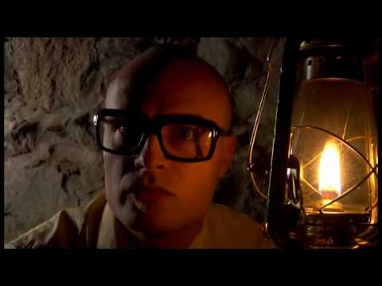
Notes:
MC Frontalot - It Is Pitch Dark

Slide 2
Text Adventure Games
Daphne Ippolito
Chris Callison-Burch
http://interactive-fiction-class.org

Slide 3
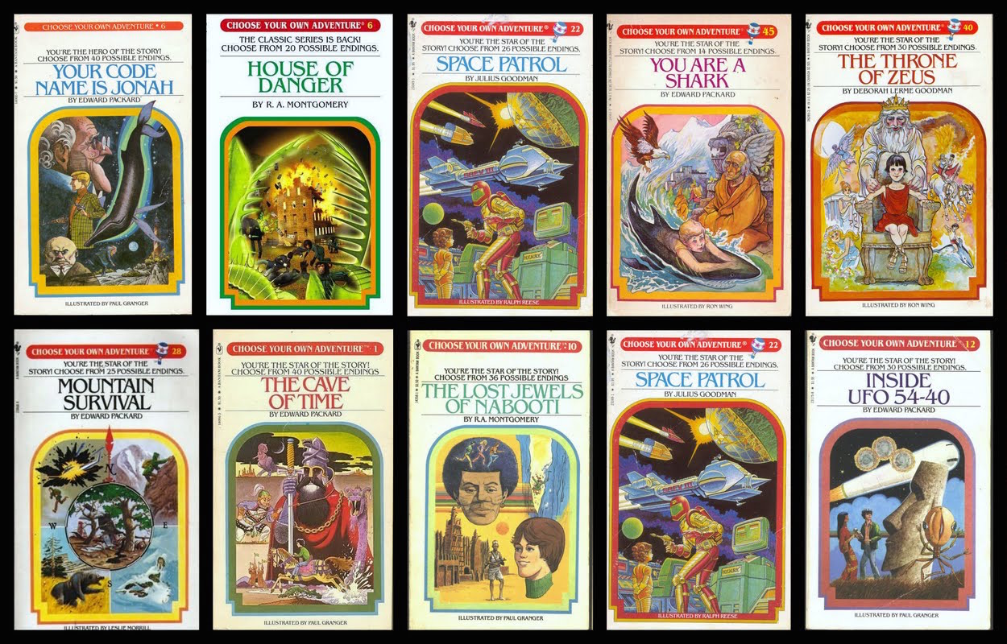
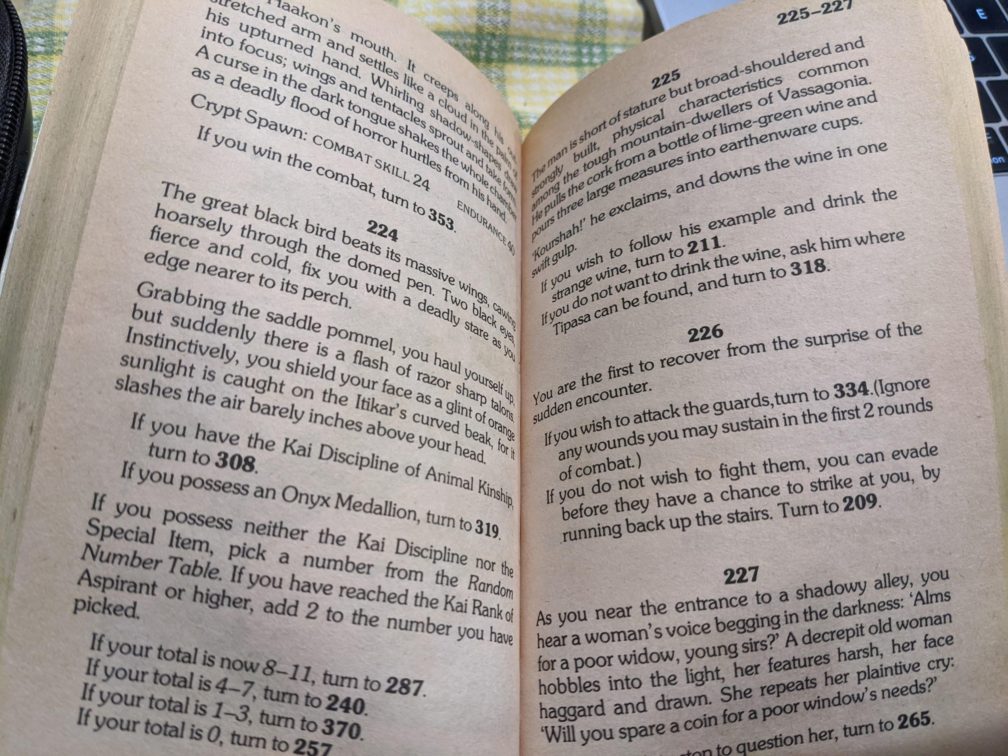
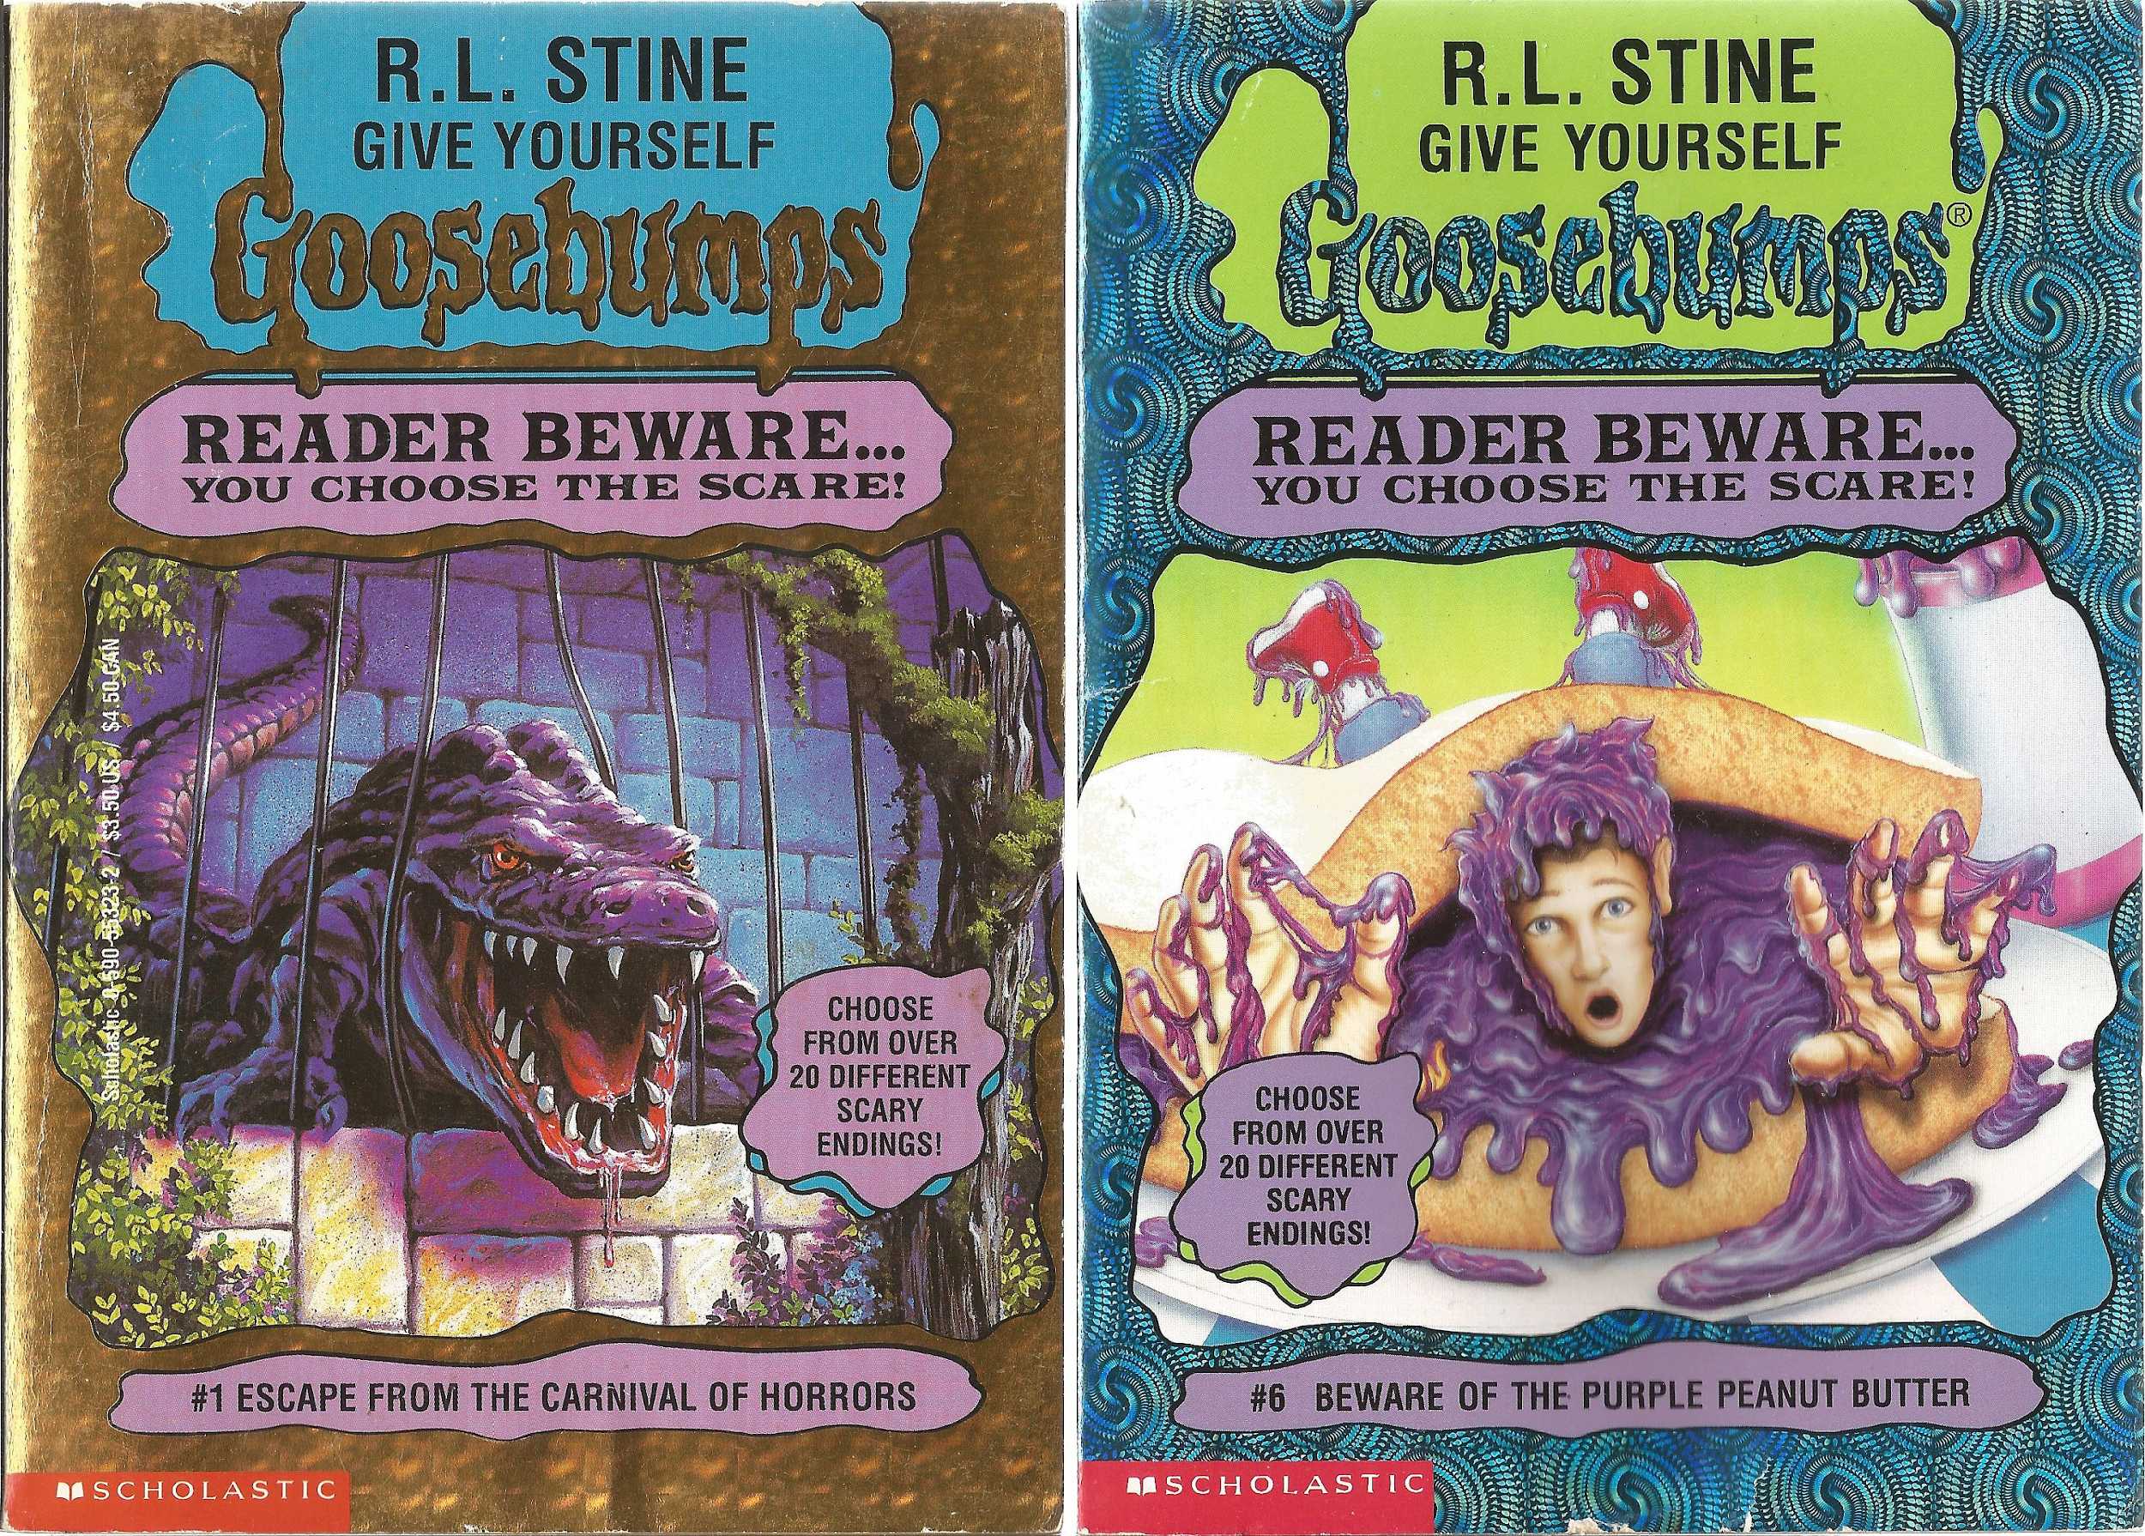
Paper Interactive Fiction
In the 1970s, “Choose your own adventure” books grew in popularity.
TODO: screenshot
Notes:
If you possess the Onyx Medallion, turn to 319.

Slide 4
Paper Interactive Fiction
In the 1970s, “Choose your own adventure” books grew in popularity.
TODO: screenshot
Notes:
If you possess the Onyx Medallion, turn to 319.
If you wish to fight them, page 334, otherwise page 209.

Slide 5
Computer Games Before Graphics

Slide 6
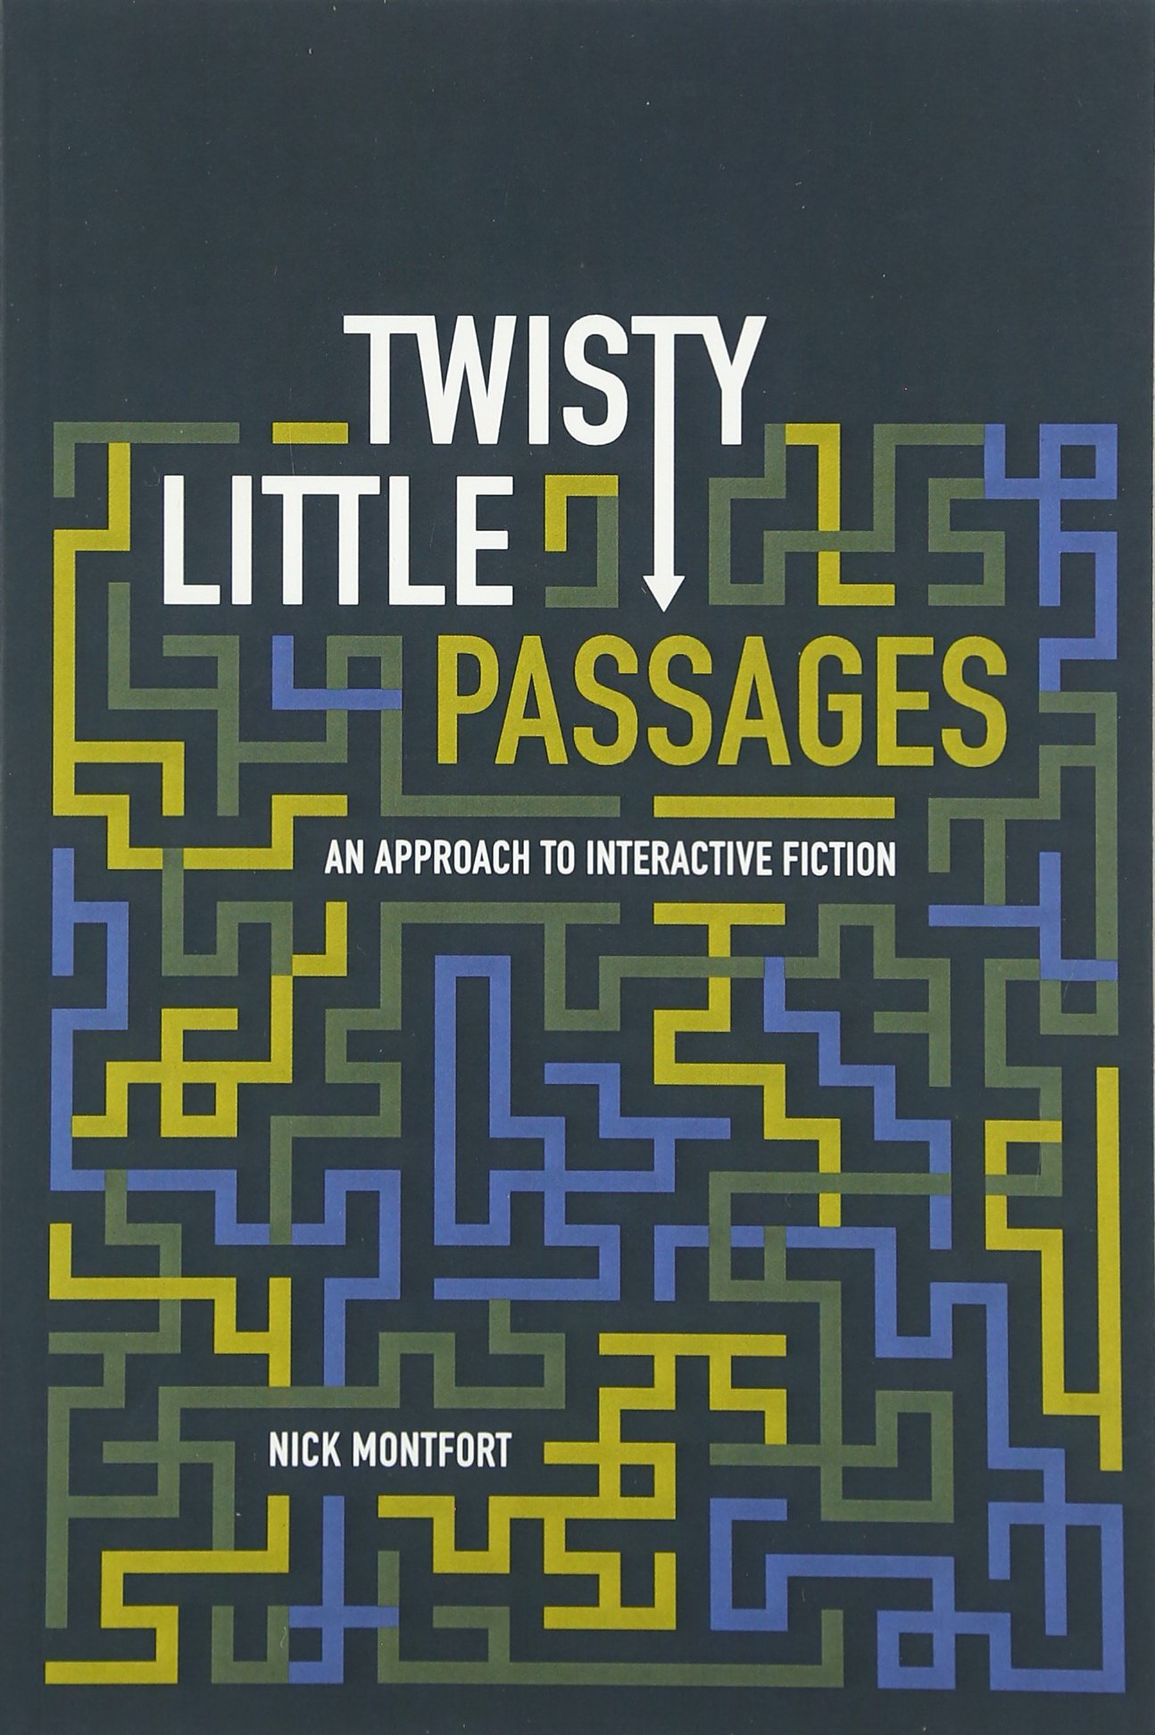
Interactive Fiction Games
The two essential components of interactive fiction are
The parser, which is the component that analyzes natural language input in an interactive fiction work.
The world model, which is setting of an interactive fiction work.
Notes:
The simulated world is represented computationally in some sort of data structure or collection of objects. It is this simulated world that distinguishes a work of interactive fiction from a conversational character or from an expert system that employs natural language understanding.

Slide 7
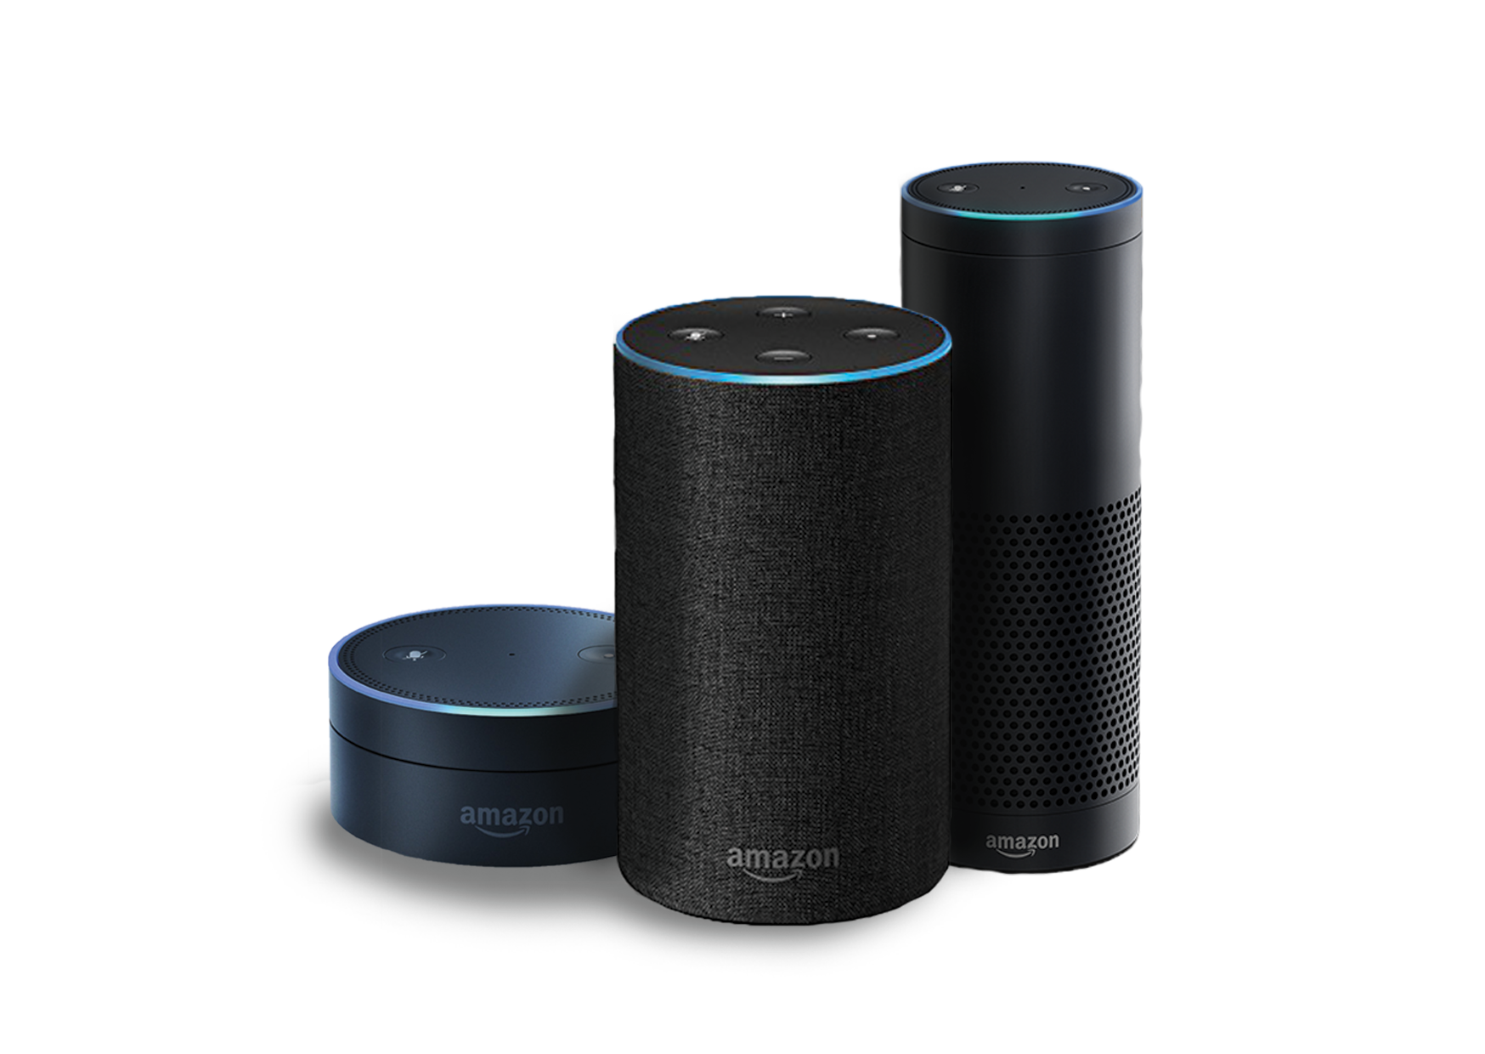

Natural Language Understanding
Will it rain tomorrow? Set an alarm for 6:30a.m. Play music from They Might Be Giants. How many pints are in a gallon? Add blueberries to my shopping list. When did California become a state? When is the Winter solstace? What is the weather like in Hawaii this weekend? Turn off the lights. Open the pod bay doors.

Slide 8
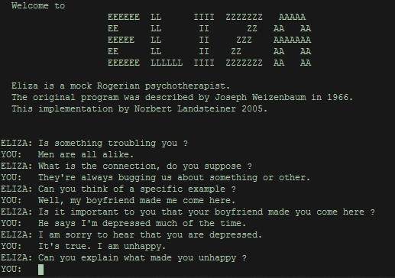
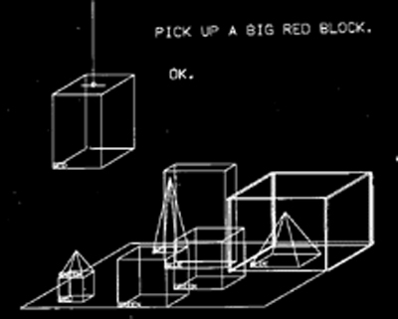
Natural Language Understanding

Slide 9
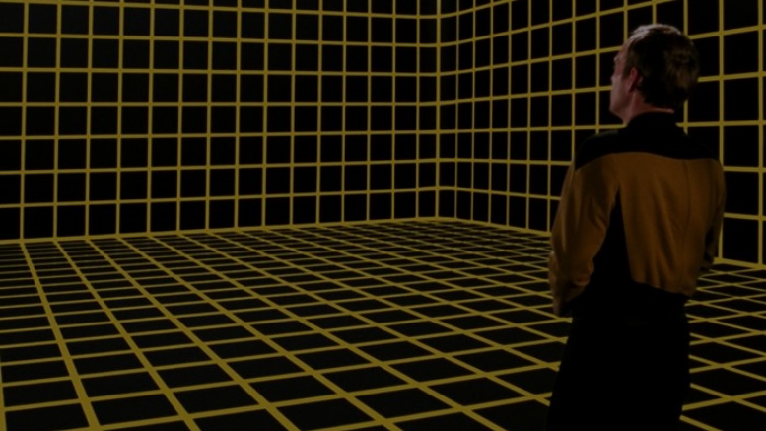
Simulated World
The simulated world distinguishes a work of interactive fiction from a conversational character or from an expert system that employs natural language understanding.
It represents the physical environment, and the things in the environment, including characters, any physical objects in the setting that can be manipulated or further examined in any way, and the player character. It also represents, and simulates, the physical laws of that setting.
Notes:
The world model is typically implemented in the interactive fiction program as some type of graph or tree with associated procedures.

Slide 10
Locations

Slide 11
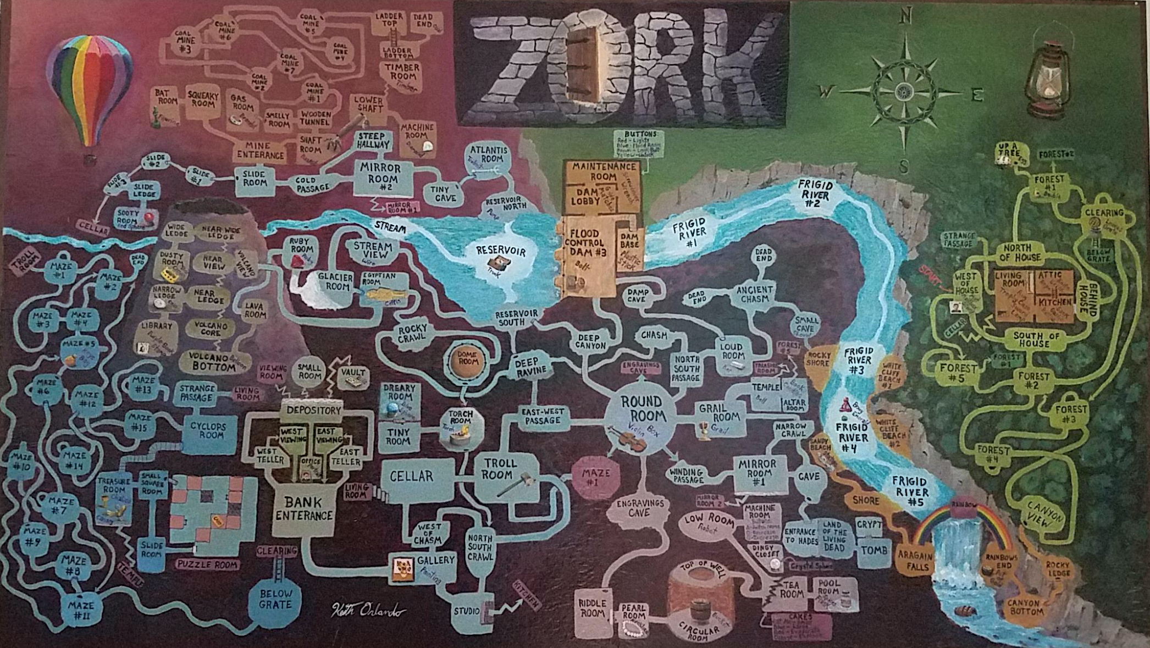
Notes:
Credit: Reddit user ion_bond Source URL: https://www.reddit.com/r/zork/comments/5ximil/zork_map_mit_version_fantastic_game_i_spent_some/

Slide 12
Objects

Slide 13
Verbs

Slide 14
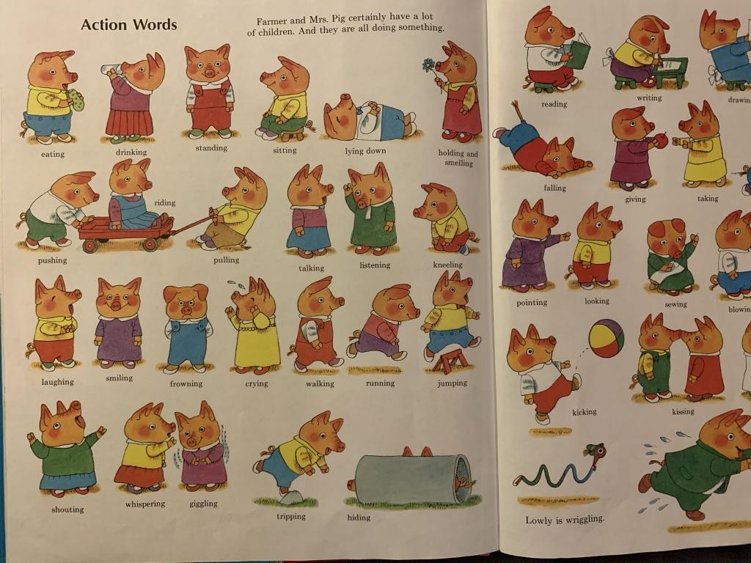
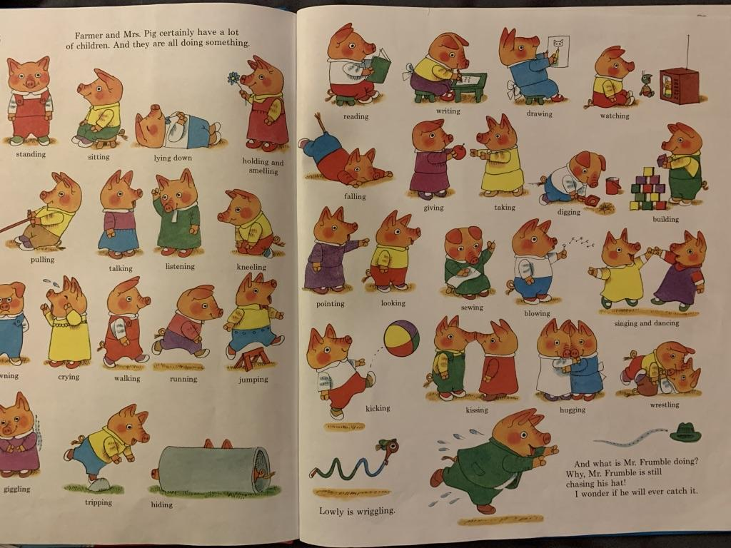
Notes:
Verbs

